Slide 1

Data Driven Decision for New York Taxi Service
Esmael
8/13/2020
Data Incubator

Slide 2
Introduction
For-hire vehicles operating in NY has grown from 63,000 to more than 100,000
However, while the number of trips in app-based vehicles has increased from 6 million to 17 million a year
Taxi trips have fallen from 11 million to 8.5 million

Slide 3
Motivation
Liberate the data to get insight and make the taxi market competitive
Develop a prediction model for fair pricing
Analyze the impact of the fair pricing on demand

Slide 4
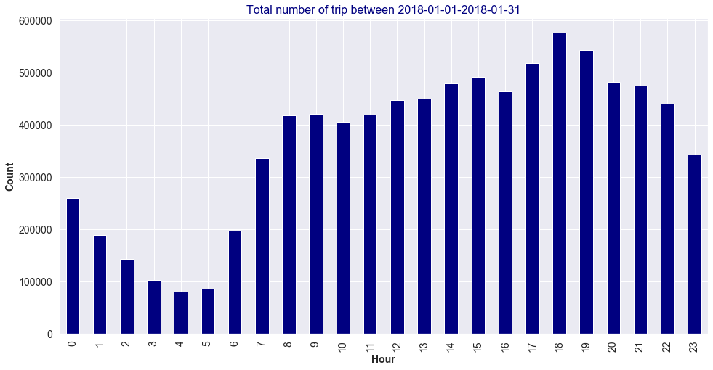
Preliminary data analysis

Slide 5
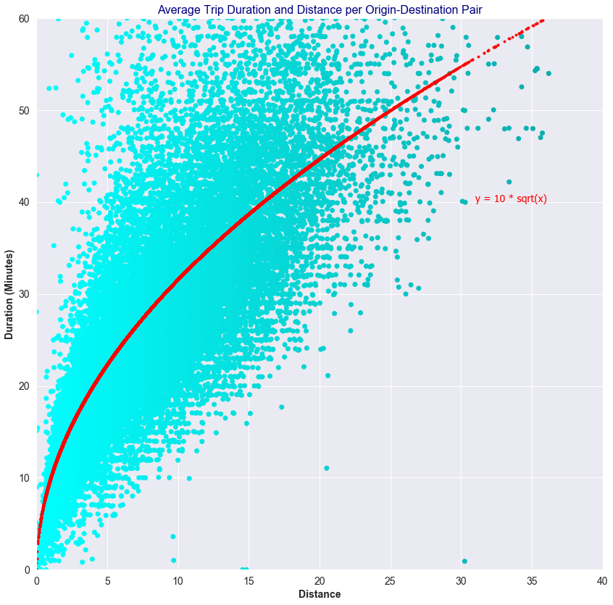
Preliminary data analysis

